Slide 1

THE RUST PROGRAMMING LANGUAGE
HARSORA RUSHIT
MA019

Slide 2
TODAY'S AGENDA
Control And Safety
In The Real World
Comments
Basic Rust Program

Slide 3
Types of comments in rust
// - Line Comment
/*...*/ - Block Comment

Slide 4
What is control ?
The Ability To Run Some Code Depending On Whether A Condition Is True And To Run Some Code Repeatedly While A Condition Is True are Basic Building Blocks In Most Programming Languages.
The Most Common Constructs That Let You Control The Flow Of Execution Of Rust Code Are If Expressions And Loops.

Slide 5
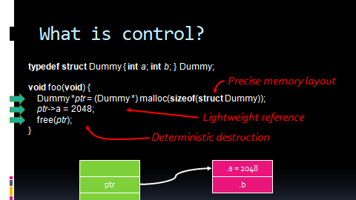

Slide 6
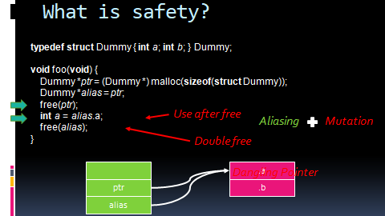

Slide 7
